Slide 1
S&P Global benefits
For Australian team members
16 March 2023

Slide 2
Disclaimer and General Advice Warning
The information contained in this presentation is general in nature and should not be relied on as advice (personal or otherwise) because your personal needs, objectives and financial situation have not been considered. Before deciding whether a particular product is right for you, please read the relevant Product Disclosure Statement or speak to a financial adviser.
Confidentiality Notice
Information contained in this document is confidential. It must not be disclosed to any third parties, or otherwise be reproduced, stored or transmitted, other than as permitted by law or with our prior written approval.
Privacy Notice
Aon has always valued the privacy of personal information. If you would like a copy of our Privacy Policy, you can contact us or access it from our website at www.aon.com.au.
Aon has taken reasonable care in the production of this document and the information contained in it has been obtained from sources that Aon reasonably believes to be reliable. Aon however, does not make any representation as to the accuracy of any information received from third parties and is unable to accept any liability for any loss incurred by anyone who relies on the contents of this document to the extent permitted by law. The recipient of this document is responsible for their use of it. Please feel free to contact us if you would like any further information.

Slide 3
Agenda
Activity undertaken
Super fund tender
Looking at super
Default provider
Considerations for different team member groups
S&P AMP and IHS CFS super members
Markit AustralianSuper members
Other
Looking at Death and TPD insurance
Death and TPD outside default superannuation fund
Death and TPD inside default superannuation fund
Next Steps
Information coming from AustralianSuper
Timing

Slide 4
Activity undertaken
1

Slide 5
A quick summary
Super fund tender
Selection of one default superannuation fund
AustralianSuper
Effective from 1 July 2023

Slide 6
Looking Super
2

Slide 7
Default superannuation provider
S&P Global Australia has decided to appoint AustralianSuper as the default superannuation fund provider.
The effective date of the transfer for default members’ future contributions is 1 July 2023.
S&P Global contributes 11% of Ordinary Time Earnings Salary with no capping*
All superannuation expenses and premiums (other than the AIA ROSP) will be paid out of members’ account balances.
The investment choice will automatically be the MySuper investment option. You can then select from the investment options.
Anyone who does transfer to AustralianSuper will need to complete a “Nomination of Beneficiary form”. Note that this is a separate form to the nomination of beneficiary form they will need to complete for the AIA ROSP but they can choose to have the same beneficiaries etc.
*Apart from bonuses which do not have the superannuation contribution paid on them if the contribution for the quarter is over the Superannuation Guarantee (SG) rate times the Maximum Contributions Base.
The Superannuation plan provides you with income in retirement. S&P Global’s contributions will increase to:
11.5% on 1 July 2024, and
12% on 1 July 2025.

Slide 8
Considerations for different groups of team members
3

Slide 9
S&P AMP and IHS CFS Super members
Your super contributions will automatically be paid to the newly chosen default fund from 1 July 2023, but you can opt out by completing a Choice of Fund form with your current (or another) superannuation fund listed.
Your current balance and any associated insurance will stay with your current fund unless you elect to transfer it over. If you want to transfer AustralianSuper will assist you and more information will come from them in due course:
The new provider may take on current insured amounts without requiring underwriting. If you want to do this, you will need to apply to AustralianSuper once you are a member. We suggest that you do not cancel any cover until accepted by AustralianSuper.
You also need to decide if you want to do step 1 before you transfer your balance from AMP if you want it consolidated as there is no insurance cover if there is no balance to pay the premiums
We suggest you obtain financial advice before making decision about insurance and your superannuation.

Slide 10
Markit AustralianSuper members
Your contributions are already going to AustralianSuper and that will not change.
There is a process AustralianSuper takes to transfer your membership from the current to the new offer – or the team members can stay in the section of AustralianSuper they are already in.
AustralianSuper will communicate with impacted team members on this.

Slide 11
Other team members
You have either made your own choice of fund or joined since 1 November 2021 and are stapled to a fund you joined prior to working with S&P Global.
Your contributions will continue to be paid to your current fund unless you want to opt into the new offer.
If you would like to join AustralianSuper you will need to complete a Choice of Fund form.
Your current balance and any associated insurance will stay with your current fund unless you elect to transfer it over. If you want to transfer AustralianSuper will assist you and more information will come from them in due course:
The new provider may take on current insured amounts without requiring underwriting. If you want to do this, you will need to apply to AustralianSuper once you are a member. We suggest that you do not cancel any cover until accepted by AustralianSuper.
You also need to decide if you want to do step 1 before you transfer your balance from AMP if you want it consolidated as there is no insurance cover if there is no balance to pay the premiums
We suggest you obtain financial advice before making decision about insurance and your superannuation.

Slide 12
Looking at insurance
4

Slide 13
Death and Total & Permanent Disablement (TPD) outside default superannuation fund
Effective 1 March 2023
S&P Global automatically provides all team members* with coverage of 2x your base salary (with tapering after age 60 for TPD)
This is done via the AIA Risk Only Superannuation Plan (AIA ROSP)
This is a standalone fund to receive insurance premiums only and does not affect your superannuation
This arrangement minimizes any tax payable on benefits paid to you under the policy
S&P Global pays the premiums and member fees associated with this benefit
The premium and member fee are classed as concessional contributions to a superannuation fund so will count towards your concessional contribution limit
*Automatic acceptance up to $1 million and tapering will occur between ages 60 and 65 for TPD.
TPD Insurance provides you with financial protection in the event of death or you not being able to work again as a result of accident or sickness.
Notes:
JT – 3 minutes

Slide 14
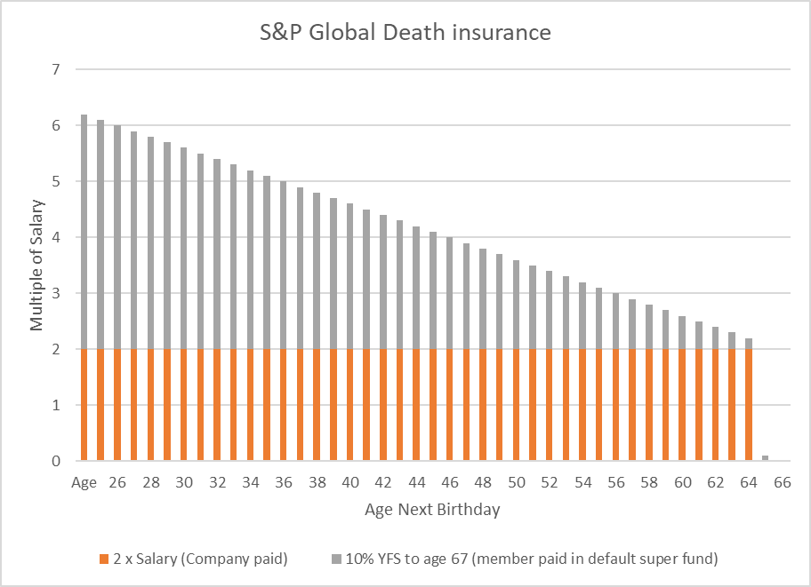
Automatic cover provided in super fund
The death and TPD insurance cover that will be provided to all S&P Global team members who join the default superannuation arrangement will be as follows:
10% x years (and complete months to count) to age 67 x base salary*
This cover will be paid out of your superannuation account balance if you are a member of the S&P Global section within AustralianSuper. You are able to opt out of this cover (or even elect to have more cover subject to acceptance by the insurer or if transfer from another fund is accepted). We suggest that you seek qualified financial advice before making any decisions regarding your insurance and super.
*Automatic acceptance limit is $1m; cover ceases age 67 for Death and 65 for TPD

Slide 15
Total Death and TPD total insurance
You may need to consider your overall death and TPD cover as you will potentially have:
2 x base salary through AIA ROSP paid by the Company
If you become a member of the new AustralianSuper offer there is 10% x future service to age 67 x base salary
Any insurance cover you have in your current fund
Any personal insurance cover you have
If you do not feel the sum of what you have is enough you can apply for more cover to the super fund but it is subject to underwriting and acceptance by the insurer
If you opt out of any insurance cover it will need to be in writing and if you subsequently change your mind then underwriting would apply and you may or may not have the cover accepted by the insurer.
Notes:
JT – 3 minutes

Slide 16
Next steps
5

Slide 17
Next Steps
You do not need to take any action with regards to the Employer paid death and TPD insurance as it will be automatically provided to you.
AustralianSuper will be providing written communication and access to a microsite (end April/early May) as well as run sessions for team members (June).
We suggest you review your current superannuation arrangements, especially in relation to insurance.
You may also consider seeking qualified financial advice which takes into account your personal needs and objectives to enable you to make an informed decision about your superannuation and insurance levels.
AustralianSuper Select Product Disclosure Statement https://www.australiansuper.com/-/media/australian-super/files/tools-and-advice/forms-and-fact-sheets/superannuation/product-disclosure-statements/pds-select.pdf

Slide 18
Questions?

